Slide 1
HEALTHY LIFE STYLE
GROUP-7

Slide 2
MEMBERS
KPTMYK-001298 MG MIN HAN SET NAING
KPTMYK-001273 MG BHONE PYAE THU
KPTMYK-001275 MA MOE MYINT MYAT TUN
KPTMYK-001285 MA MAY THIRI PAING
KPTMYK-001288 MA PANN CHERRY MYO
KPTMYK-001337 MA NADI HTWE

Slide 3
INTRODUCTION
Healthy lifestyle is an important topic for everyone because it contains many fundamental parts of human life.
A healthy lifestyle leaves you fit, energetic and at reduced risk for disease, based on the choices you make about your daily habits.
Living healthy is about maintaining a healthy lifestyle and introducing habits that will improve your health.
Healthy is essential for everyone.
Among many healthy are physical health and mental health.
As the saying goes, if you are healthy, you must live and eat healthy eating well, being physically active, and taking care of your mind as much as possible is the best way to support you health.

Slide 4
OBJECTIVE
The aim of the project is to raise awareness about the importance of having a healthy lifestyle and along with that the ways of how we can live in a healthy way.
list the guidelines for a healthy lifestyle.
Describe the health benefits of physical activity.
Identify healthy and unhealthy foods.
Understanding the importance of a healthy lifestyle among the participants.

Slide 5
IMPLEMENTATION
HOME
ABOUT
CONTACT
REVIEW

Slide 6
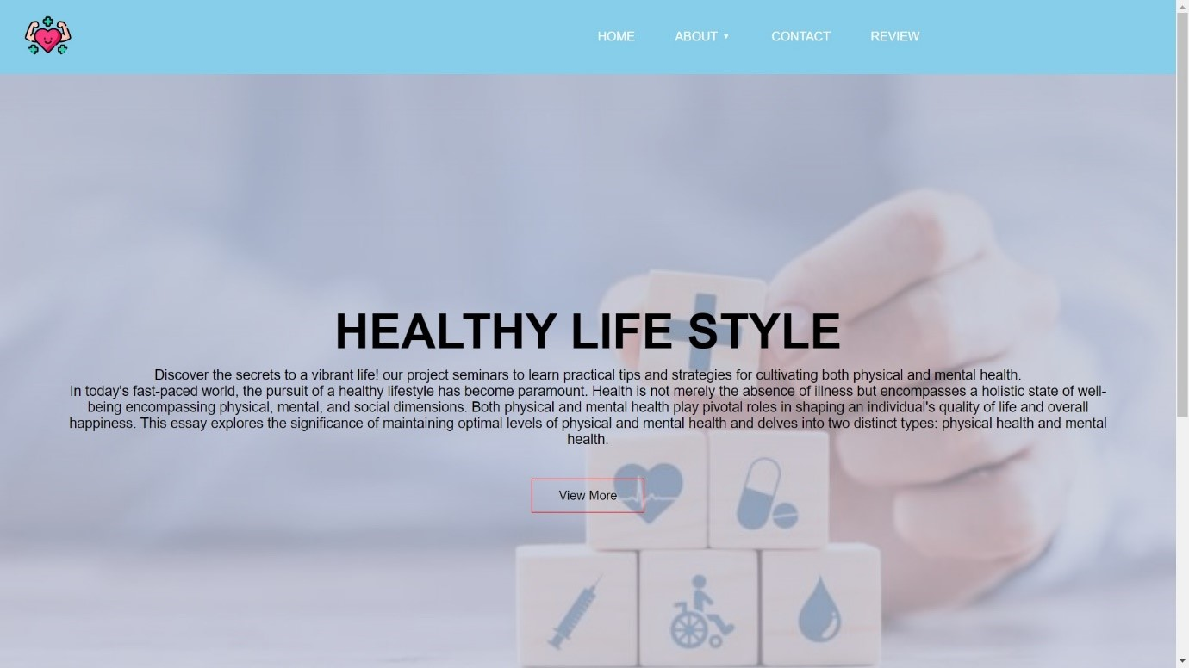
HOME PAGE
This is the home page. You can access our website by clicking view more.
Figure-1 : Home page

Slide 7

About page
The About page has two categories : physical health and mental health.
Figure-2 : About page

Slide 8
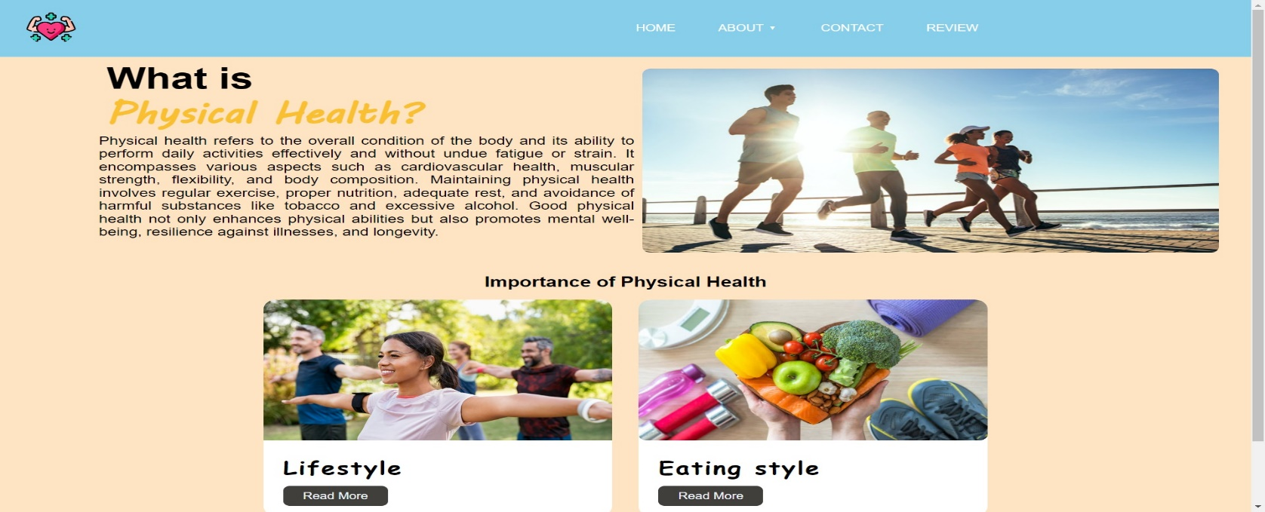
cont’d
If you click on physical health, you can see importance of physical health.
Figure-3 : About page

Slide 9
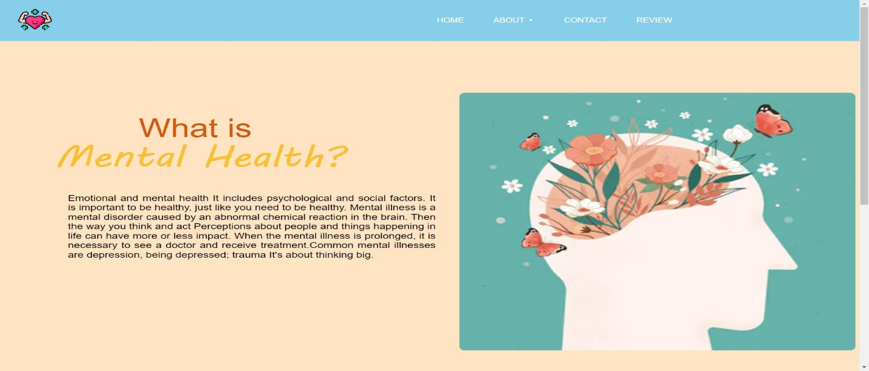
cont’d
Click the mental health, you can see what is mental health.
Figure-4 : About page

Slide 10
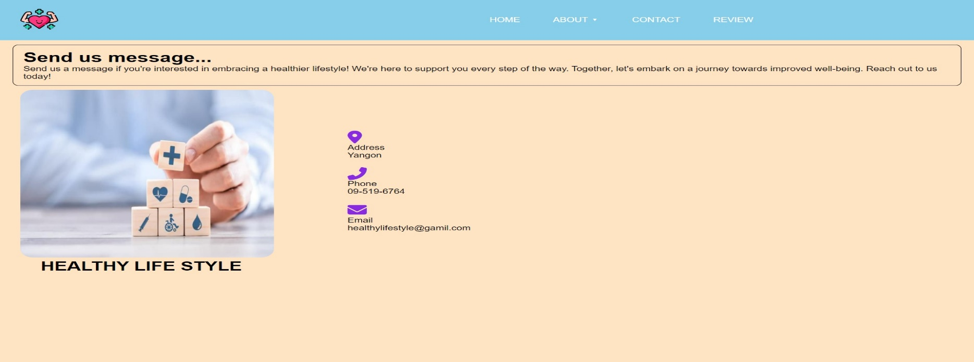
contact
If you want to know more information about health, you can continue to study on the hello doctor website.
Figure-5 : Contact page

Slide 11
conclusion
In conclusion, achieving and maintaining good health is a lifelong journey that requires conscious choices and daily commitment.
By focusing on a balanced diet, regular exercise, sufficient sleep, stress management, and avoiding harmful habits, you can significantly improve your well-being. Additionally, staying proactive with preventive healthcare and nurturing your mental health and social connections are equally essential.
Remember that good health is a precious gift, and it's up to you to protect and nurture it throughout your life.
Your choices today will shape your health for years to come, so make them count.

Slide 12
references
Web Development and Design Foundations With Html5, Terry Felke-Morris, 6th Edition
W3C
Web Professionals
GreeksforGreeks
W3Schools
Hello Doctor

Slide 13

Thank you

